Slide 1
Problem Solving
Strategy: Form an Equation

Slide 2
Learning Intention
To understand algebraic representations
Success Criteria
I can:
define variables
combine variables to form expressions
generalise a pattern with an algebraic expression
construct a mathematical model (equation) to solve a problem
Problem Solving Strategy:
Form an Equation

Slide 3
Problem Solving Cycle
Understand the problem
Make a plan
Look back
Carry out the plan

Slide 4
Strategy: Form an equation
Make a plan

Slide 5
Strategy: Form an equation
Forming an equation is like translating from normal language into the language of formulas.
Are there words in the problem that might mean some quantities are equal?
Look for words like: is, are, was, equals, will be, gives, results in, yields, sold for, cost
Can you translate your variables into equations?
How are your variables connected?

Slide 6
Strategy: Form an equation
Alice is 4 years older than her brother. In three years time she will be twice his age. How old is Alice now?

Slide 7
Strategy: Form an equation
Alice is 4 years older than her brother. In three years time she will be twice his age. How old is Alice now?
Define variables
Let Alice’s age be a and her brother’s age be b
a = b + 4
Check: If b = 10 then a = 10 + 4 = 14, so Alice would be 4 years older

Slide 8
Strategy: Form an equation
Alice is 4 years older than her brother. In three years time she will be twice his age. How old is Alice now?
In three years time Alice’s age will be a + 3 and her brothers age will be b + 3
a + 3 = 2(b + 3)

Slide 9
Strategy: Form an equation
Alice is 4 years older than her brother. In three years time she will be twice his age. How old is Alice now?
Solve:
a = b + 4 [1]
a + 3 = 2(b + 3) [2]
(b + 4) + 3 = 2(b + 3) Substituting [1] into [2]
b + 7 = 2b + 6
b + 7 – b = 2b + 6 – b Subtracting b from both sides
7 = b + 6, therefore b = 1, and a = 1 + 4 = 5
So Alice is 5 years old now.

Slide 10
Learning Intention
To understand algebraic representations
Success Criteria
I can:
define variables
combine variables to form expressions
generalise a pattern with an algebraic expression
construct a mathematical model (equation) to solve a problem
Problem Solving Strategy:
Form an Equation
Notes:
This is to leave on the screen whilst students work

Slide 11
Age old problems
Alice is nine years older than Barry. In eight years time Alice will be twice Barry’s age. How old is Alice now?
Catherine is twelve years younger than Dorothy. In six years Dorothy will be twice Catherine’s age. How old is Catherine now?
Edgar if three times Fred’s age. When Edgar’s age has trebled, he will be four years older than Fred. How old is Fred now?
Garry is half Hannah’s age. In 40 years time Garry will be two-thirds of Hannah’s age. How old is Garry now? [Garry and Hannah are tortoises that live for a really long time]

Slide 12
Age old problems
Ten years ago Ian was twice Jo’s age. Now Jo is 14 years younger than Ian. How old is Ian now?
Kate is 15 years younger than Larry. 14 years ago Larry was four times older than Kate. Is Kate allowed to vote? [Sorry, got bored of asking how old someone is]

Slide 13
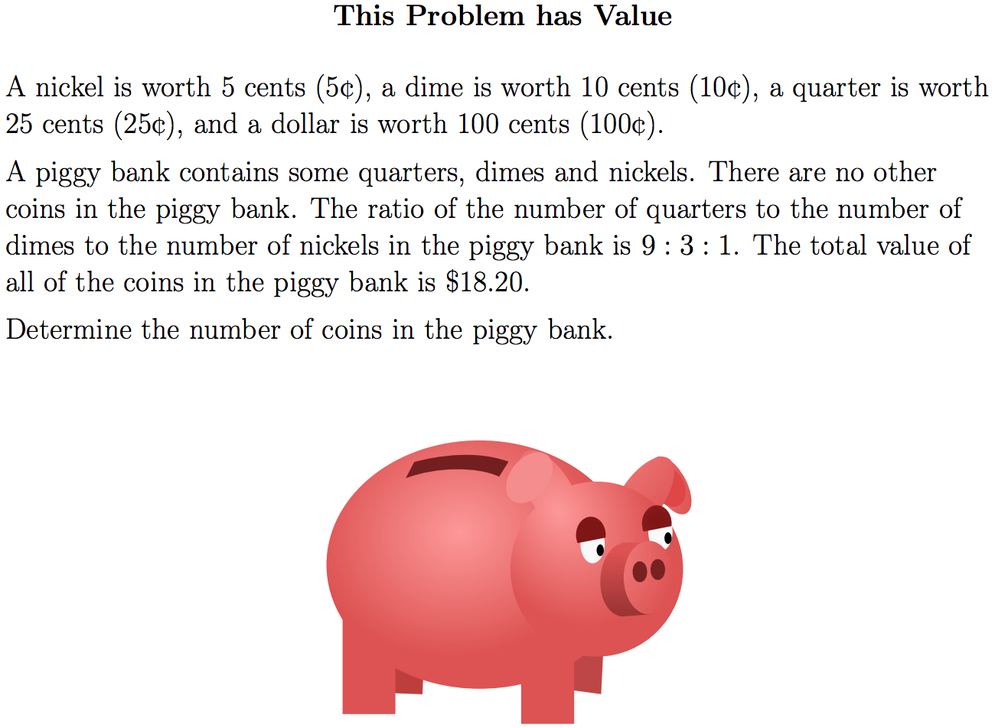
Notes:
Print this slide, and the previous slide (double sided) to hand out to students.

Slide 14
About average (warm up)
Think of four numbers whose average is 100
Then, think of four different, positive integers whose average is 100
Notes:
Print this slide, and the previous slide (double sided) to hand out to students.

Slide 15
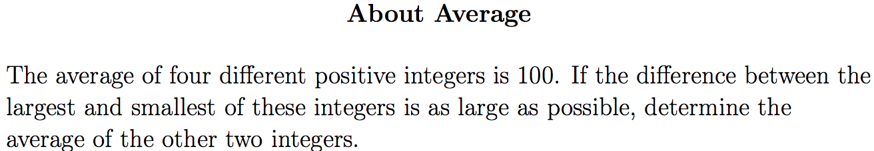
Notes:
Print this slide, and the previous slide (double sided) to hand out to students.

Slide 16
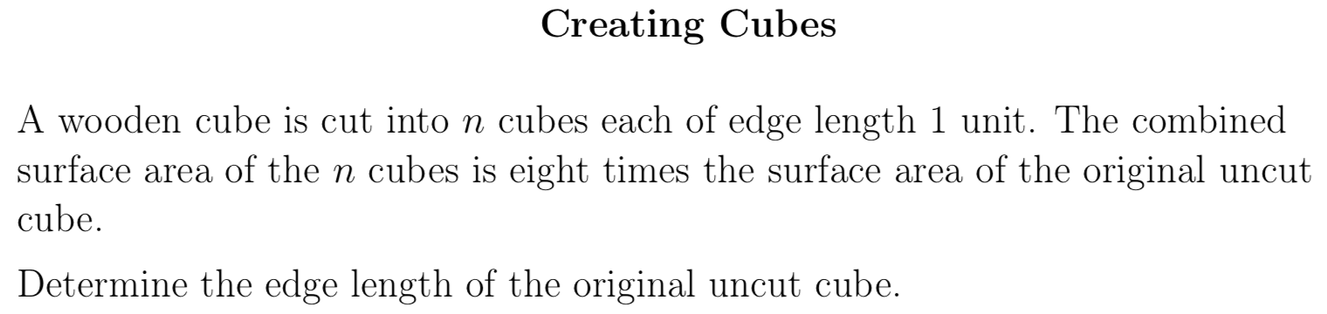

Notes:
Print this slide, and the previous slide (double sided) to hand out to students.

Slide 17
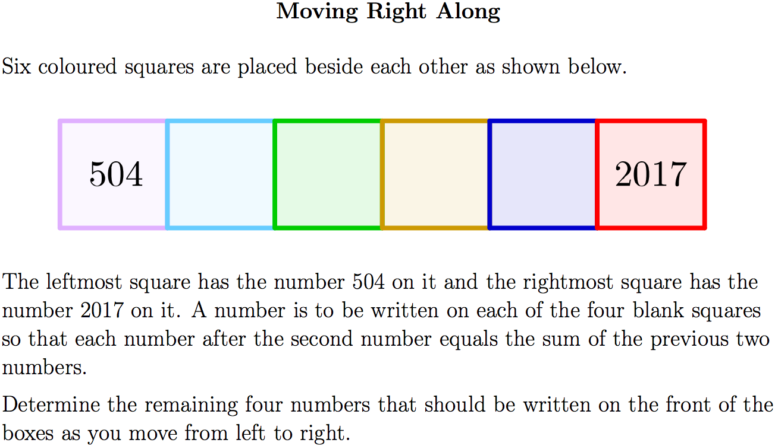
Notes:
Print this slide, and the previous slide (double sided) to hand out to students.

Slide 18
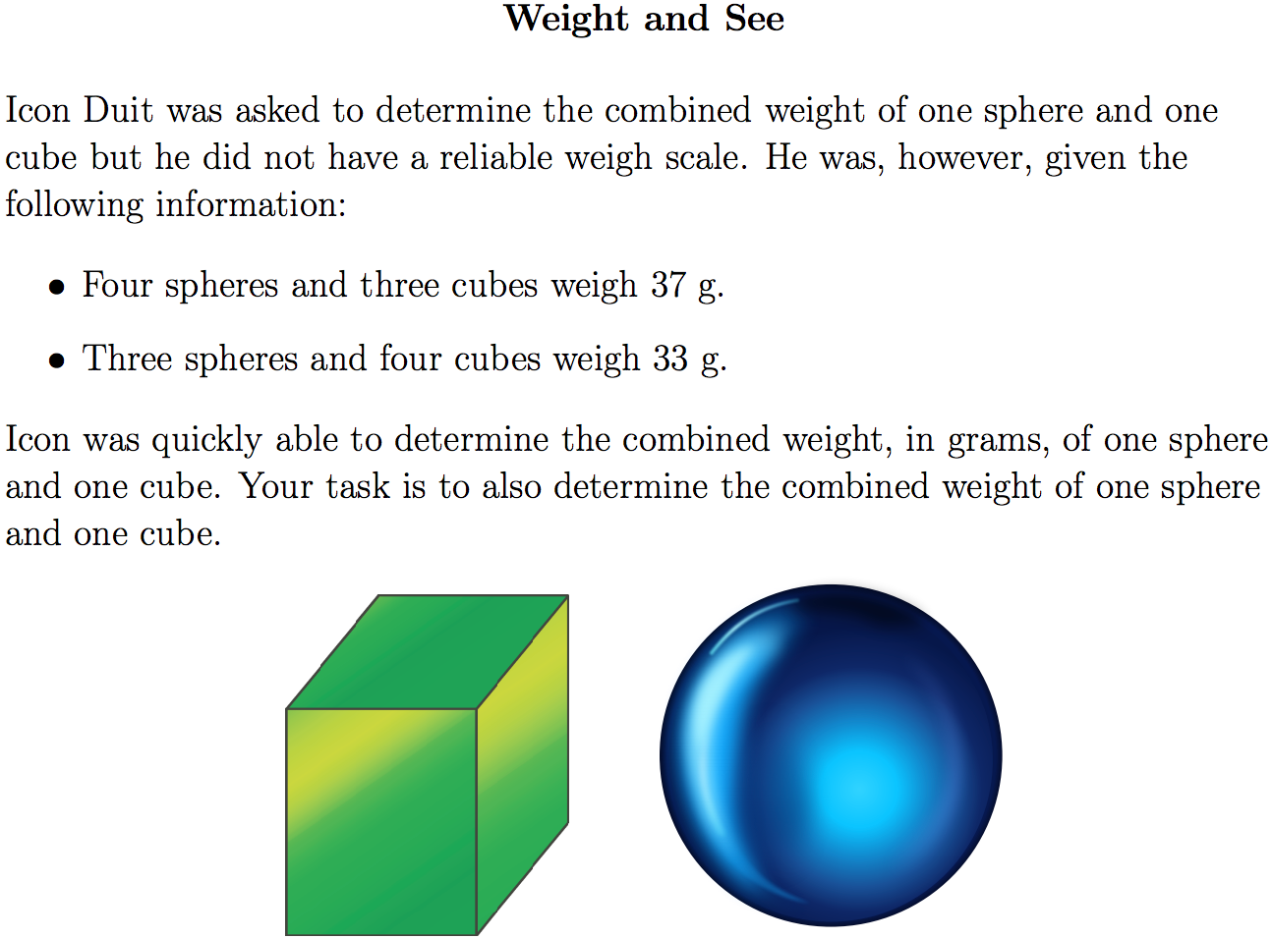
Notes:
Print this slide, and the following (double sided) to hand out to students.

Slide 19
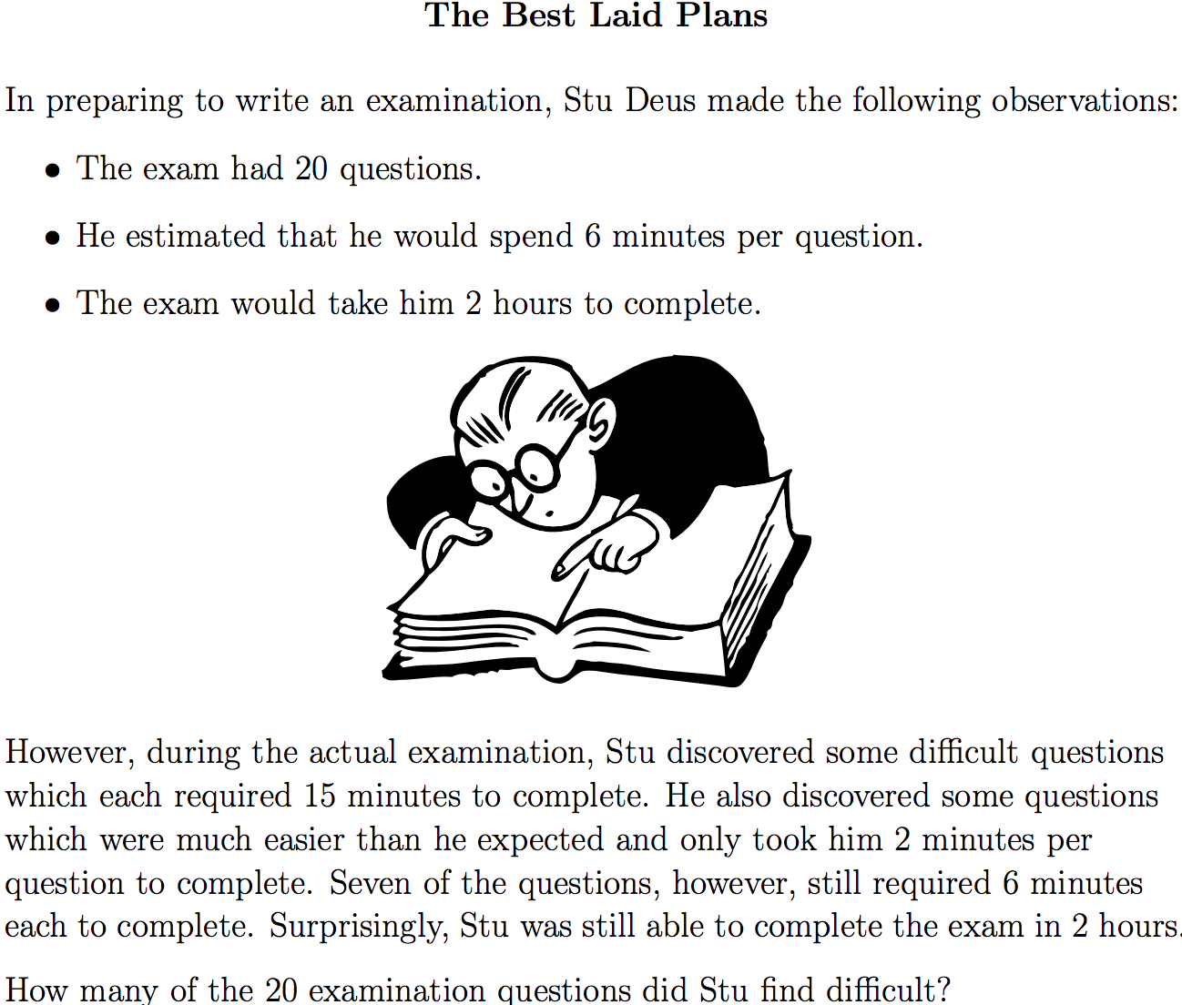
Notes:
Print this slide, and the previous slide (double sided) to hand out to students.

Slide 20
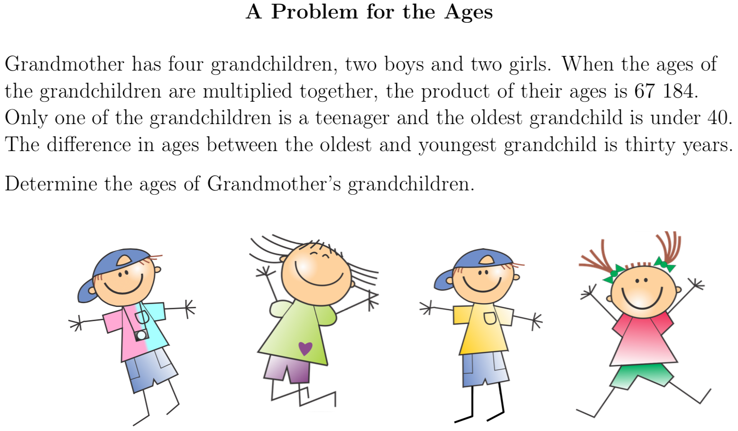
Notes:
Print this slide, and the following (double sided) to hand out to students.

Slide 21
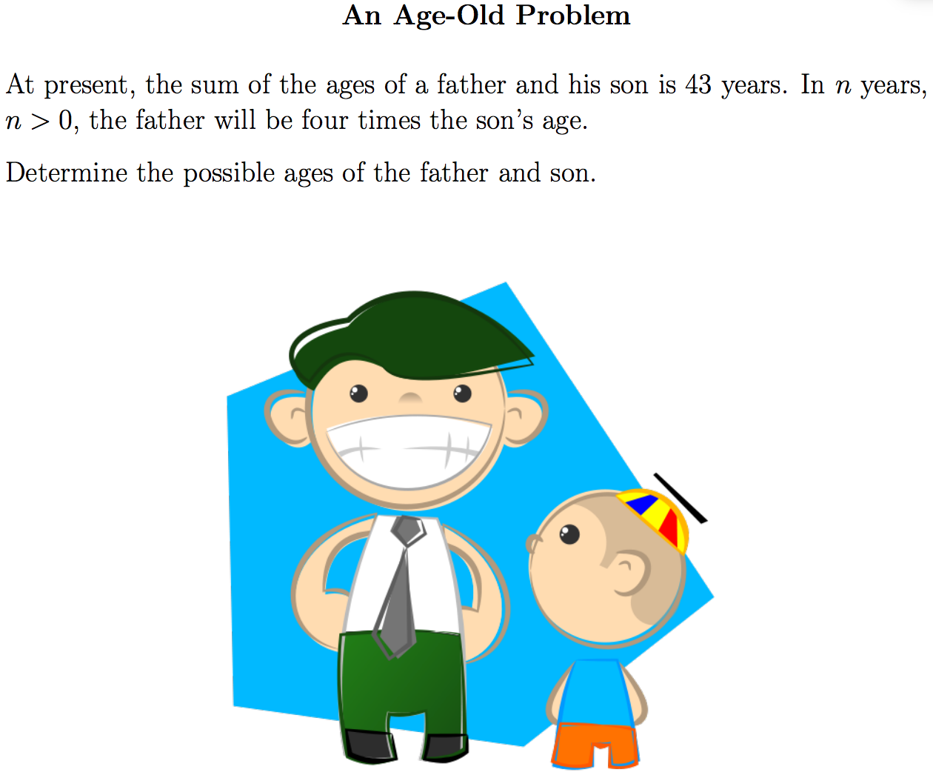
Notes:
Print this slide, and the following (double sided) to hand out to students.

Slide 22
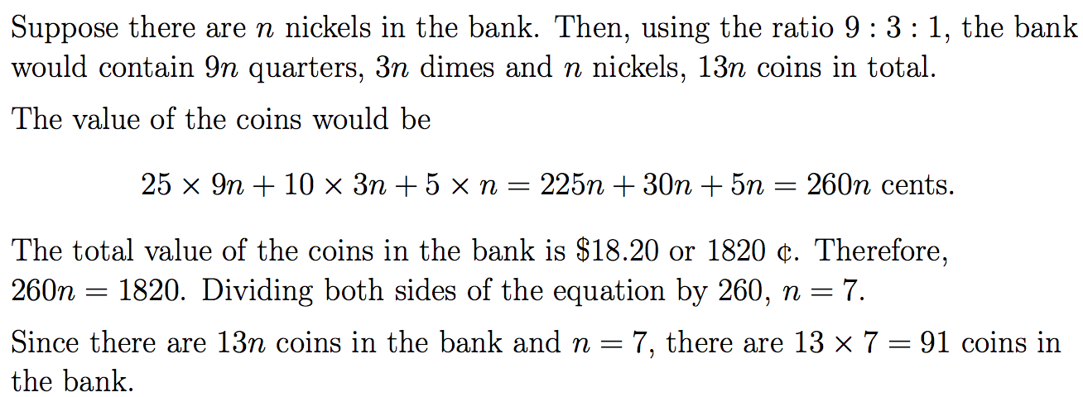
This problem has value Solution

Slide 23
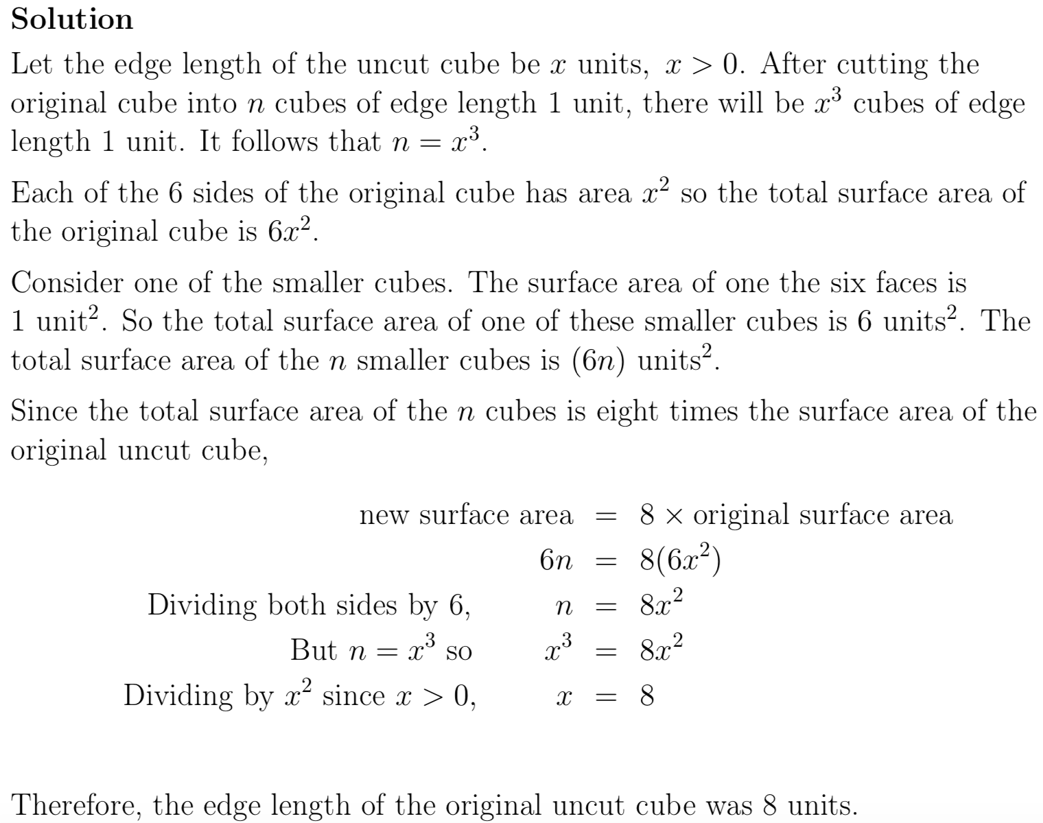
Cube Solution

Slide 24
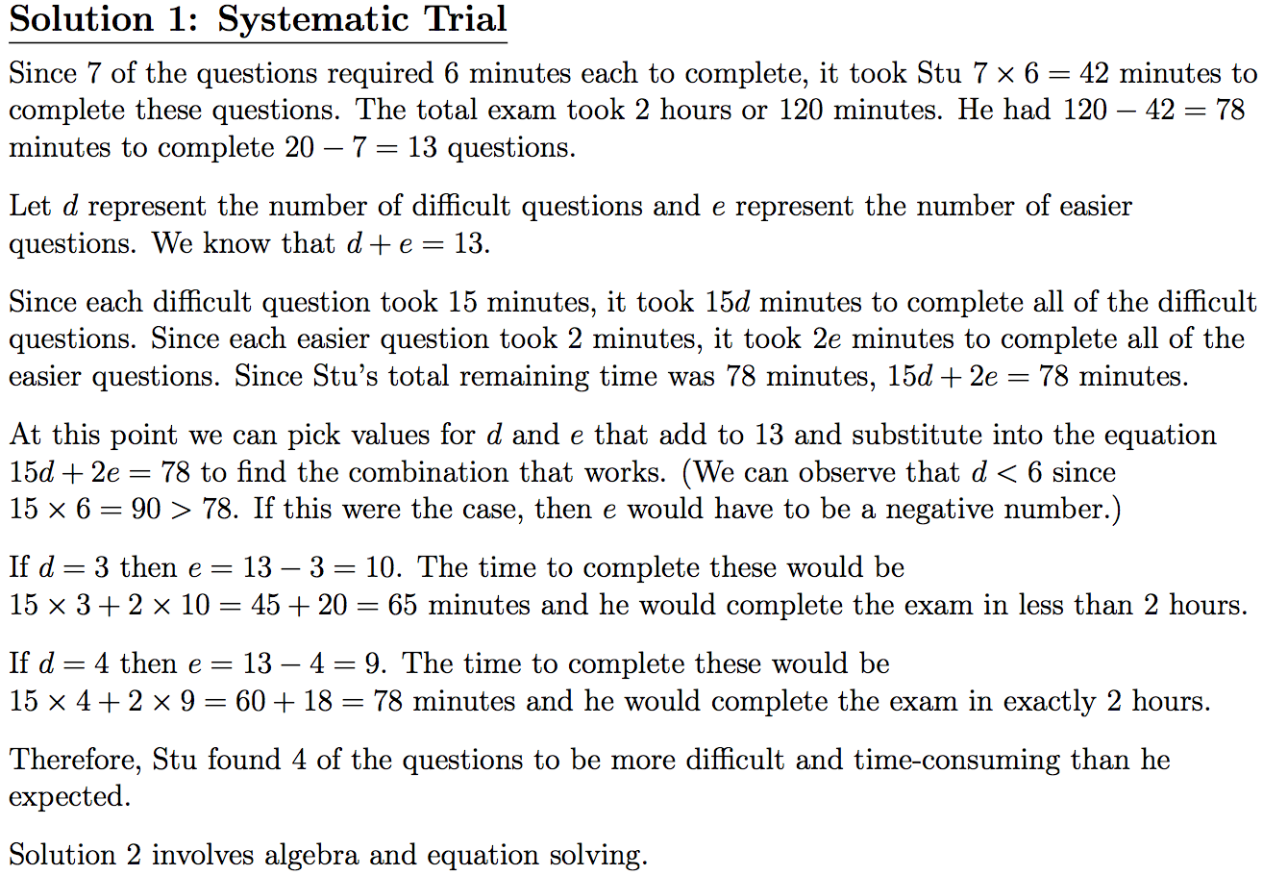
Best Laid Plans Solution

Slide 25
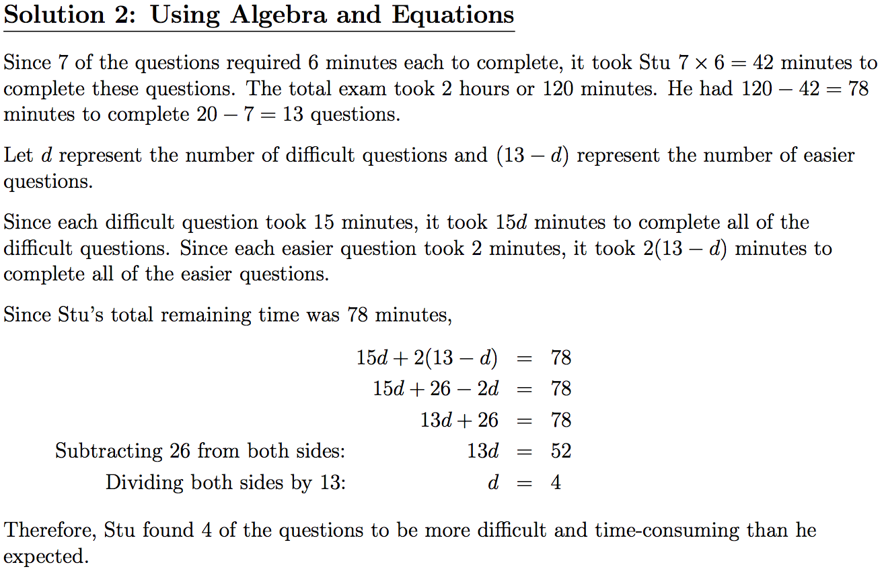
Best Laid Plans Solution

Slide 26
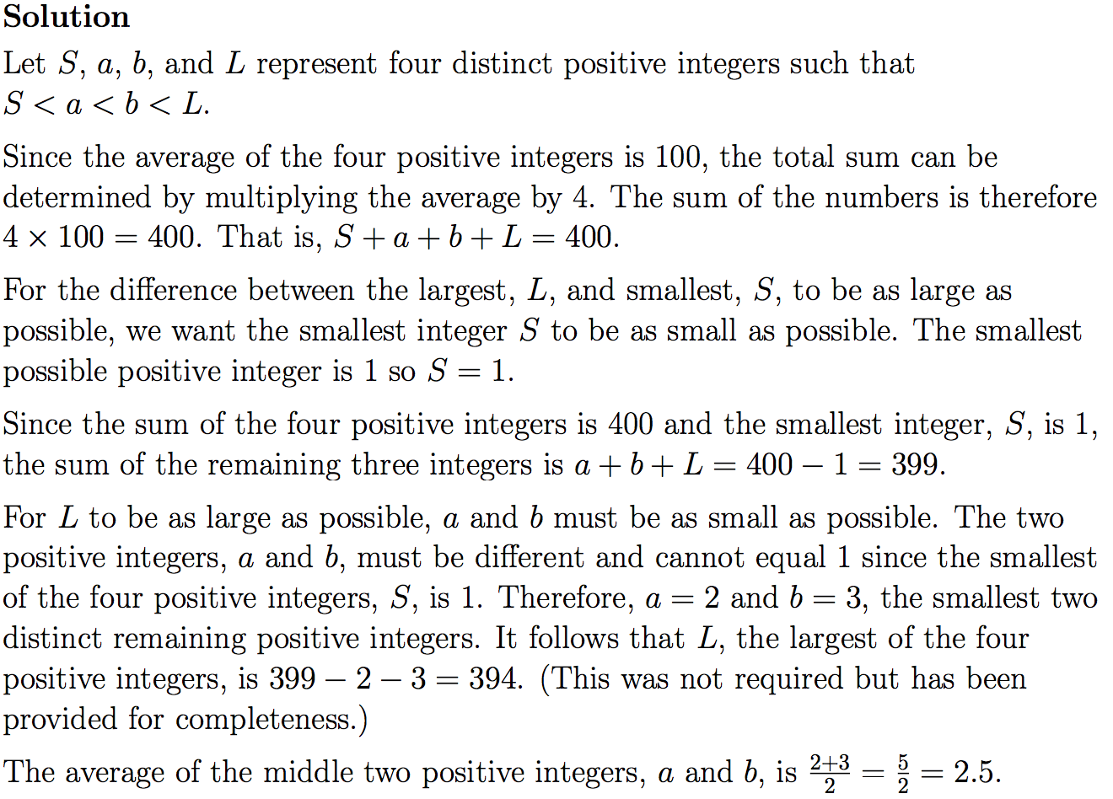
About Average

Slide 27
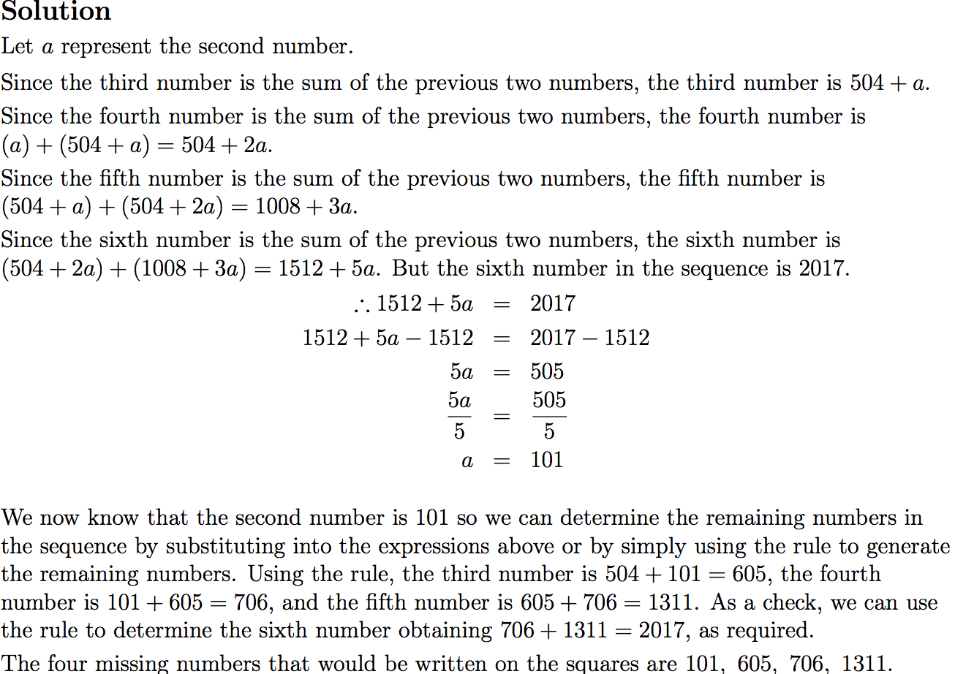
Move Right Along

Slide 28
Put solution to problem of ages here.
It will be long.

Slide 29
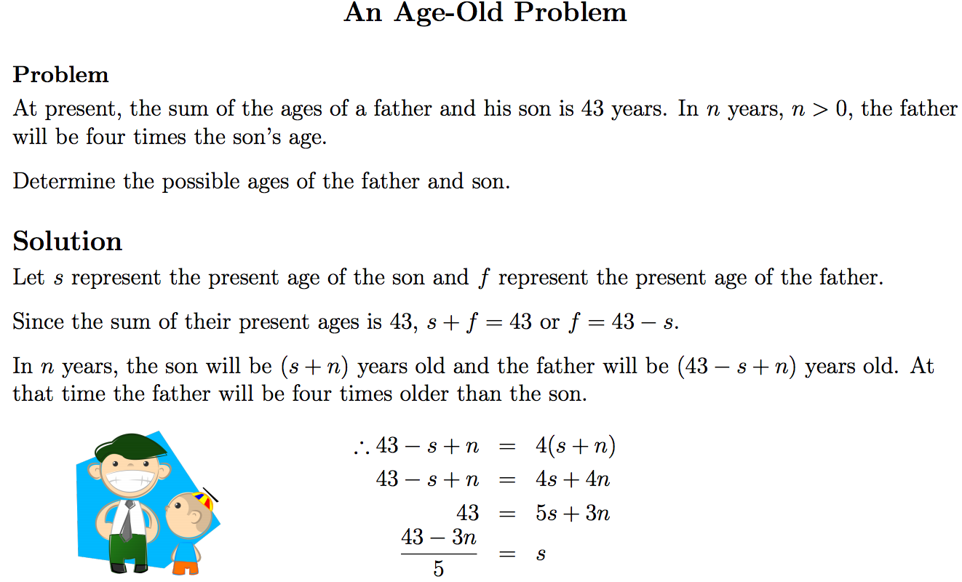

Slide 30
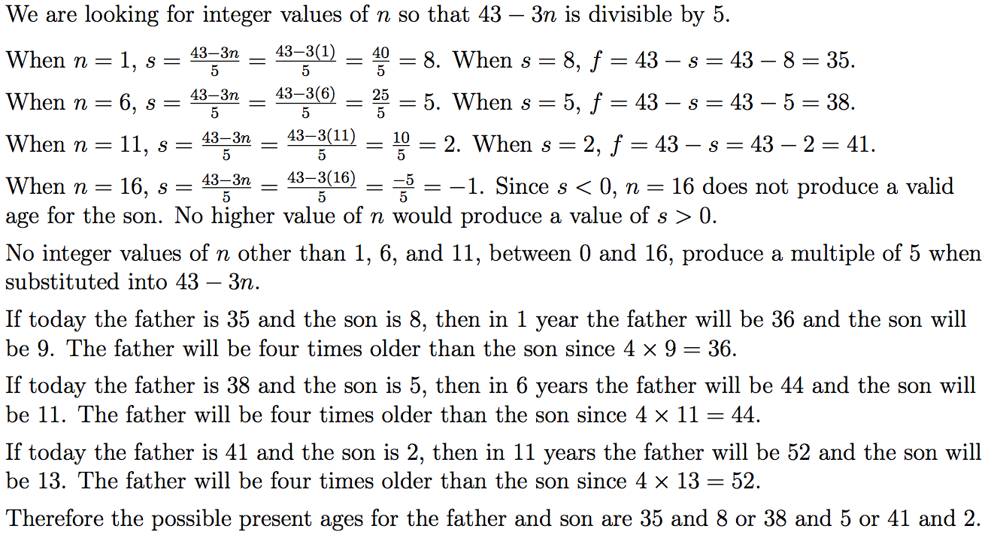

Slide 31
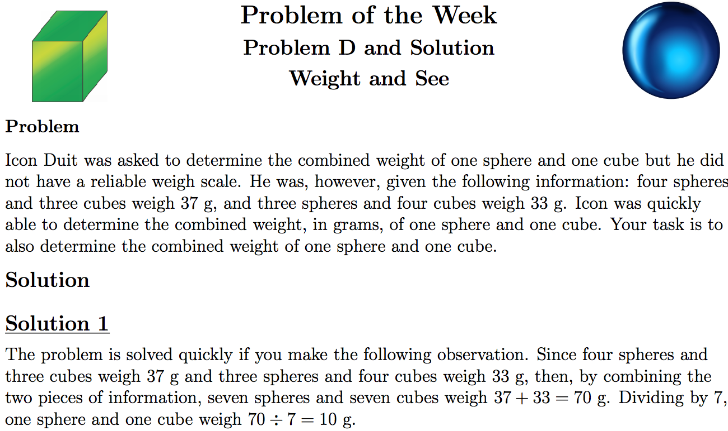

Slide 32
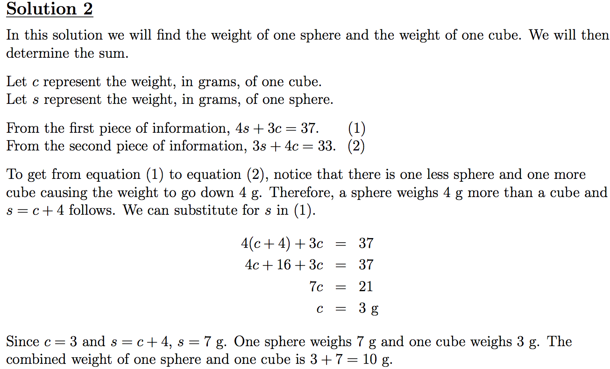

Slide 33
